Slide 1
PixMix Inpainting
Presented by: Zhang Xianyao
Zhang Yu
Tong Yuqiang
Implementation of TVCG’14 paper
High-Quality Real-Time Video Inpainting with PixMix

Slide 2
Outline
The task: (video/image) inpainting
Object removal
The method: Pix-Mix for object removal
Object selection (Tong Yuqiang)
Object tracking (Zhang Yu)
Inpainting (Zhang Xianyao)
The result

Slide 3
Outline
The task: (video/image) inpainting
Object removal
The method: Pix-Mix for object removal
Object selection (Tong Yuqiang)
Object tracking (Zhang Yu)
Inpainting (Zhang Xianyao)
The result: plausible and fast

Slide 4
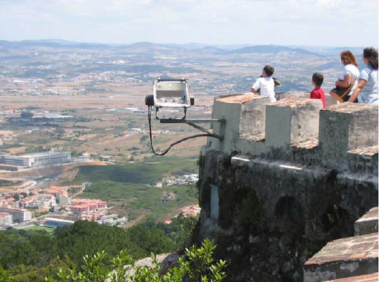
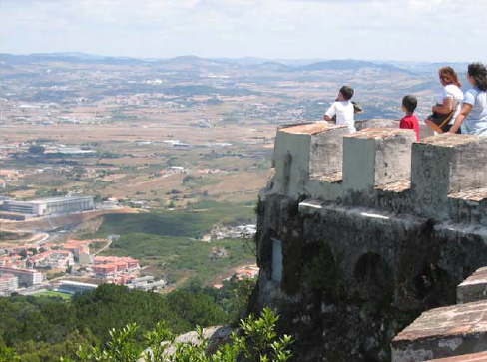
Inpainting/Object Removal

Slide 5
Outline
The task: (video/image) inpainting
Object removal
The method: Pix-Mix for object removal
Object selection (Tong Yuqiang)
Object tracking (Zhang Yu)
Inpainting (Zhang Xianyao)
The result: plausible and fast

Slide 6
Video Inpainting Pipeline
First frame
Successive frames (i-1 and i)
Frame 1
Result 1
Result i-1
Result
i
Fill
Fill
Constr.
1
f(p)
1
f(p)
i-1
f(p)
i
GUI
Track
Object i
Object 1
Object i-1

Slide 7
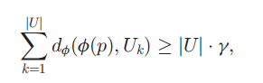
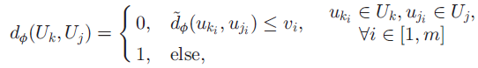
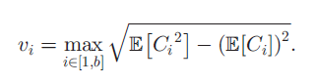
Object Selection
User gives approx. contour
All in background
Serves as fingerprints
Object = Pxs not like fingerprints
How to define similarity?
Simple rule: by color difference
Clustering is important

Slide 8
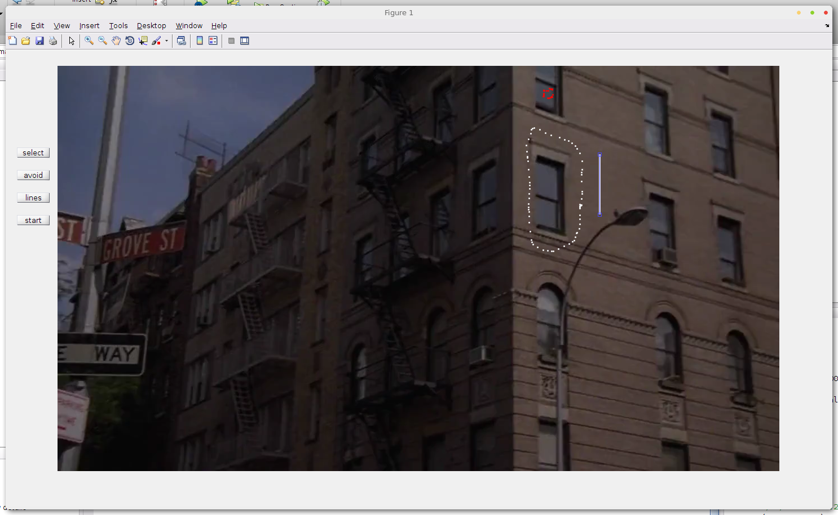
Object Selection - GUI
Object selection
Line constraint
Unused area

Slide 9
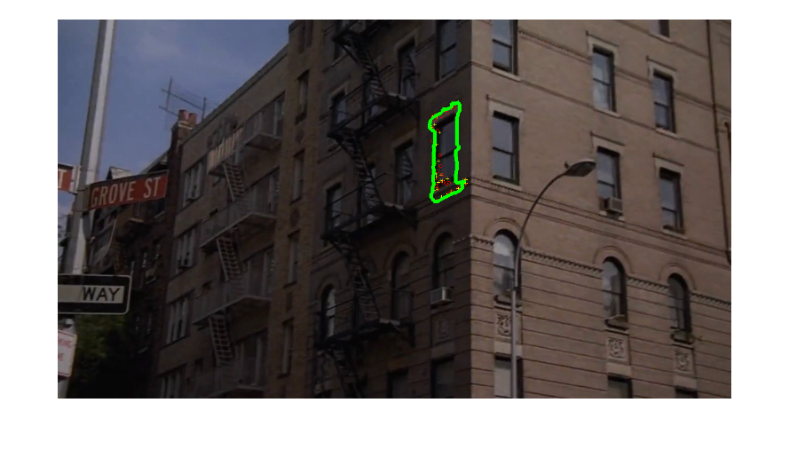
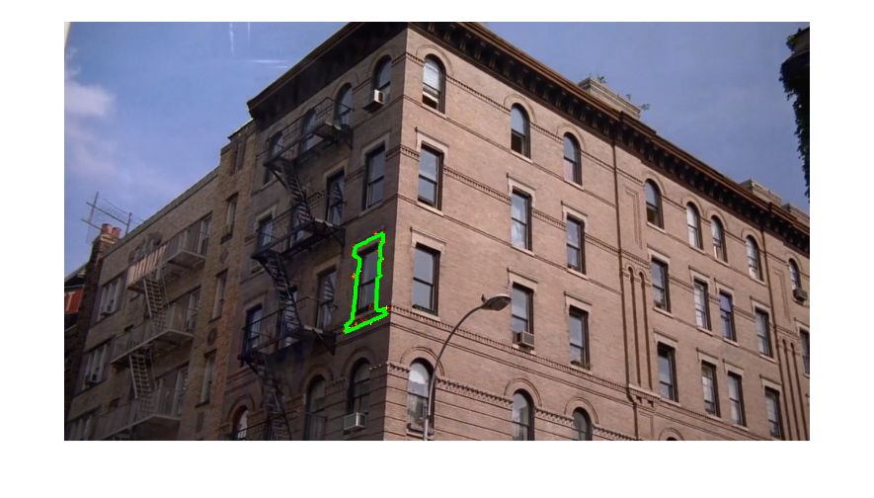
Object Tracking - Overview
Specification
In: object contour in the first frame + video
Out: contour in successive frames
General approach
Feature detection
Feature tracking
Transformation calculation
Contour refinement

Slide 10
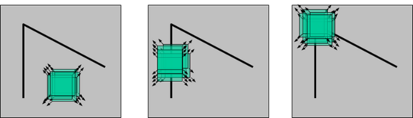
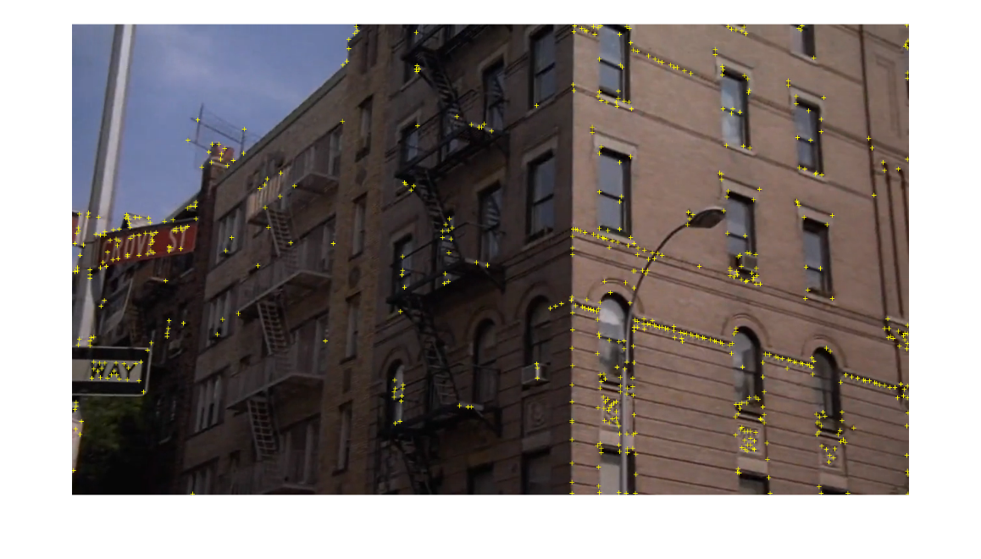

Object Tracking – Feature Detection
Using Harris corner
For pixels belonging to the object
Measurement
$\text{M}\text{ =}\left[\begin{matrix}I_{x}^{2} & {I_{x}I}_{y} \\ I_{x}I_{y} & I_{y}^{2}\end{matrix}\right]$
R = det(M) – k*${tr(M)}^{2}$
Revision
Local maximum
Response function
Notes:
人各个方向上移动这个特征的小窗口，如图3中窗口内区域的灰度发生了较大的变化，那么就认为在窗口内遇到了角点。如图1中，窗口内图像的灰度没有发生变化，那么窗口内就不存在角点；如果窗口在某一个方向移动时，窗口内图像的灰度发生了较大的变化，而在另一些方向上没有发生变化，那么，窗口内的图像可能就是一条直线的线段。

Slide 11
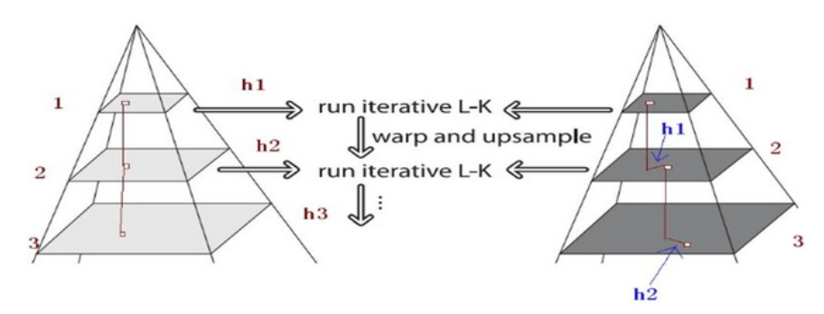

Object Tracking – Feature Tracking
Optical Flow
Match pixels with similar grey level
min $\sum_{patch}{{[I\left(W\left(X;p\right)\right)−T(x)]}^{2}}$
Feature tracking adaptive to high speed objects
Lucas-Kanade Pyramid
Notes:
总体来讲，金字塔特征跟踪算法描述如下：首先，光流和仿射变换矩阵在最高一层的图像上计算出；将上一层的计算结果作为初始值传递给下一层图像，这一层的图像在这个初始值的基础上，计算这一层的光流和仿射变化矩阵；再将这一层的光流和仿射矩阵作为初始值传递给下一层图像，直到传递给最后一层，即原始图像层，这一层计算出来的光流和仿射变换矩阵作为最后的光流和仿射变换矩阵的结果。
这里用L+1层得到的最初估计gL对L层作预平移，L层在gL的基础上求该层的光流dL，这样求得的残余光流向量dL= [dLx, dLy]T就足够小，因此能够通过标准的光流法来求出这个运动矢量。然后得到的dL结合gL又可以对L-1层的gL-1做估计。最终的光流和就是在所有层的分段光流d的叠加。使用金字塔图像计算光流的一个明显的好处是，对于一个有着较大的像素偏移的矢量d，可以通过计算几个比较小的残余光流来得到。这里就是金字塔跟踪算法的核心。

Slide 12
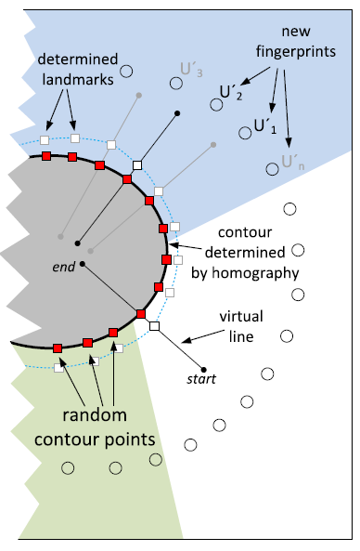
Object Tracking – Contour Refinement
Why refinement
A single transformation too coarse
How to refine
Loose the boundary and check whether it can be shrunk
Pull/push the contour specified by projective transformation
Notes:
The first pixel on the virtual line identified
as undesired and followed by at least two successive
undesired pixels defines a contour landmark for the virtual
line.

Slide 13
Object Tracking – Contour Refinement
Traversing the normal to find whether a point belong to the object or not
Reuse cluster in object selection
Random sampling for acceleration
Alternative
Dilation + object selection

Slide 14
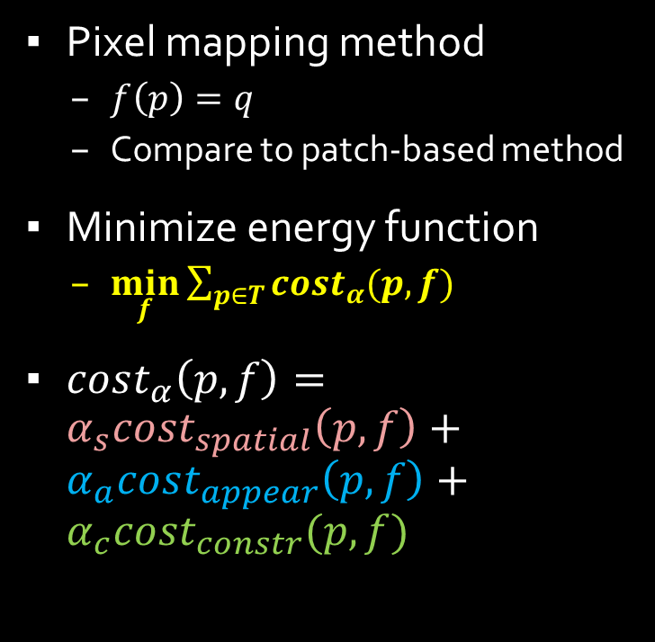
Inpainting - Overview
Pixel mapping method
$f\left(p\right)=q$
Compare to patch-based method
Minimize energy function
$\min_{f}{\sum_{p∈T}{cost_{α}(p,f)}}$
$cost_{α}\left(p,f\right)=α_{s}cost_{spatial}\left(p,f\right)+α_{a}cost_{appear}\left(p,f\right)+α_{c}cost_{constr}(p,f)$
Multi-resolution

Slide 15
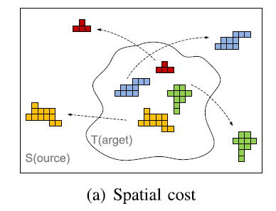
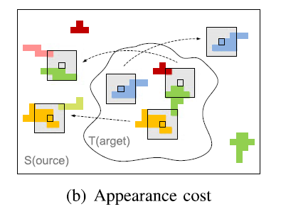
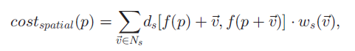
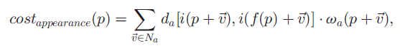
Inpainting – Cost Terms
Spatial cost
Appearance cost

Slide 16
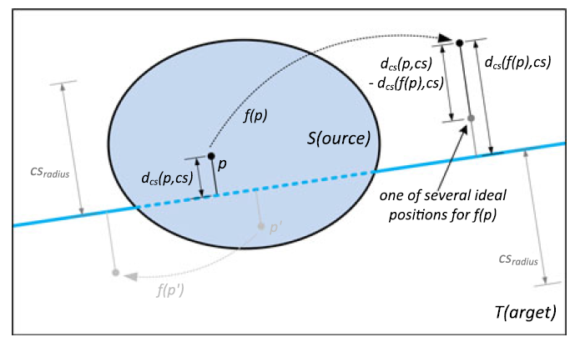
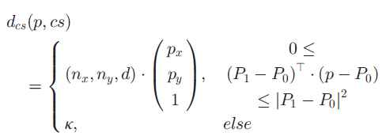
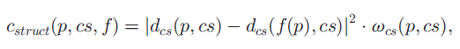
Inpainting – Cost Terms
Line constraint
Preserves important edge
Detected + user selected lines

Slide 17
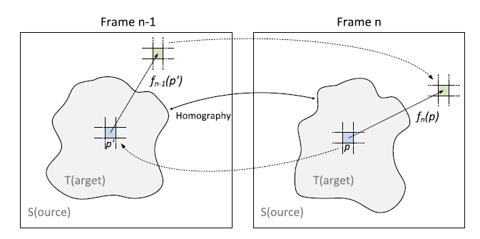
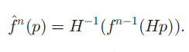
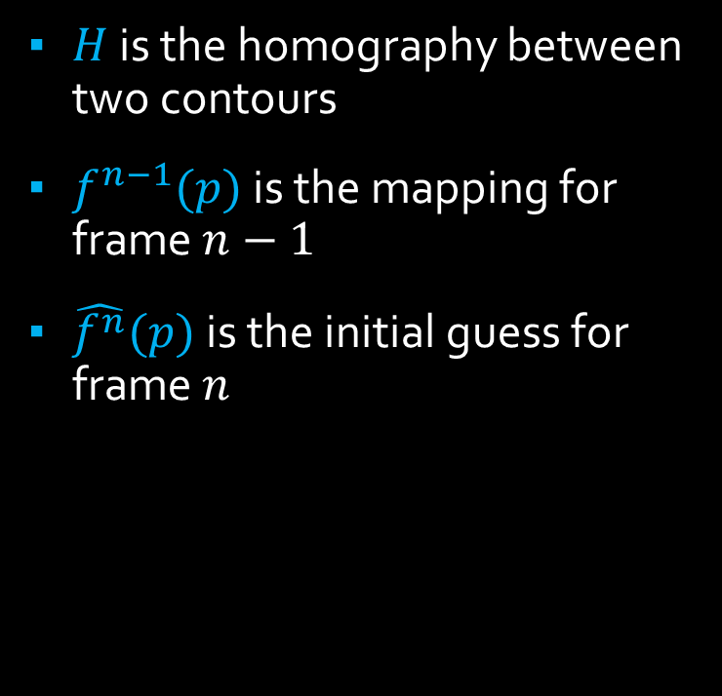
Inpainting – Mapping Forwarding
$H$ is the homography between two contours
$f^{n−1}(p)$ is the mapping for frame $n−1$
$\hat{f^{n}}(p)$ is the initial guess for frame $n$

Slide 18
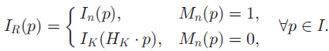
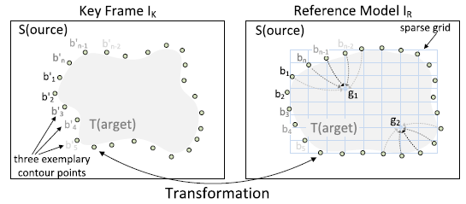
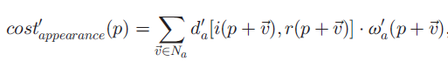
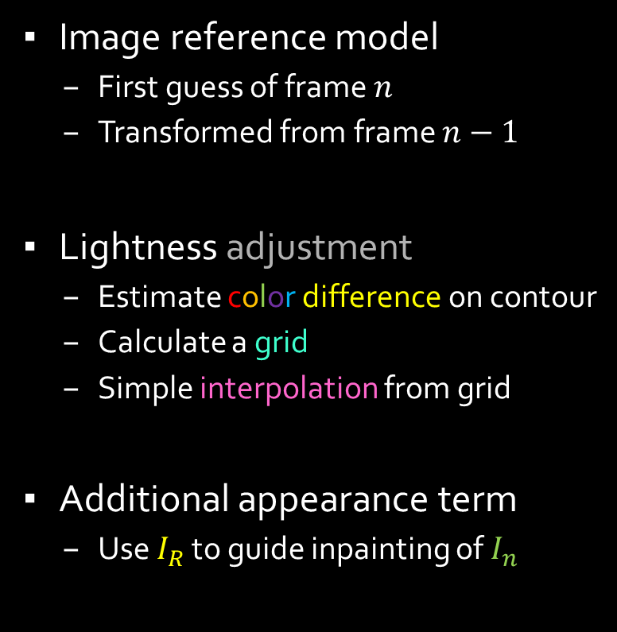
Inpainting – Reference Model
Image reference model
First guess of frame $n$
Transformed from frame $n−1$
Lightness adjustment
Estimate color difference on contour
Calculate a grid
Simple interpolation from grid
Additional appearance term
Use $I_{R}$ to guide inpainting of $I_{n}$

Slide 19
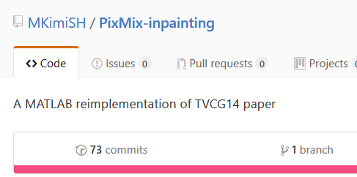
Implementation Notes
MATLAB and MEX file
GitHub for collaboration
Add a picture!!
Notes:
1. MEX is 100~1000 times faster than M file for loops
But prone to mysterious errors…
2. Vectorization is 100~1000 times faster than loops
3. MATLAB is fantastic if the algorithm is already implemented

Slide 20
Outline
The task: (video/image) inpainting
Object removal
The method: Pix-Mix for object removal
Object selection (Tong Yuqiang)
Object tracking (Zhang Yu)
Inpainting (Zhang Xianyao)
The result

Slide 21



Result: Image Inpainting

Slide 22
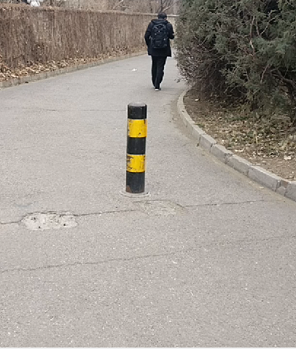
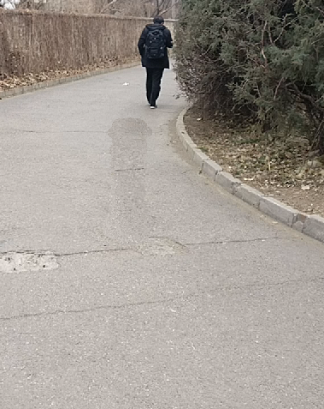
Result: Image Inpainting

Slide 23
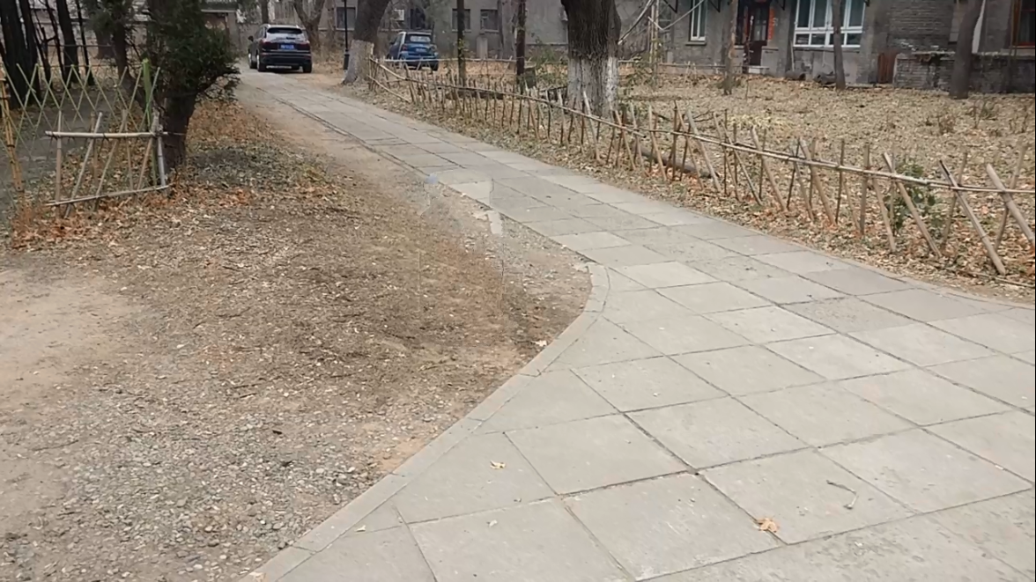
Result: Video Inpainting

Slide 24
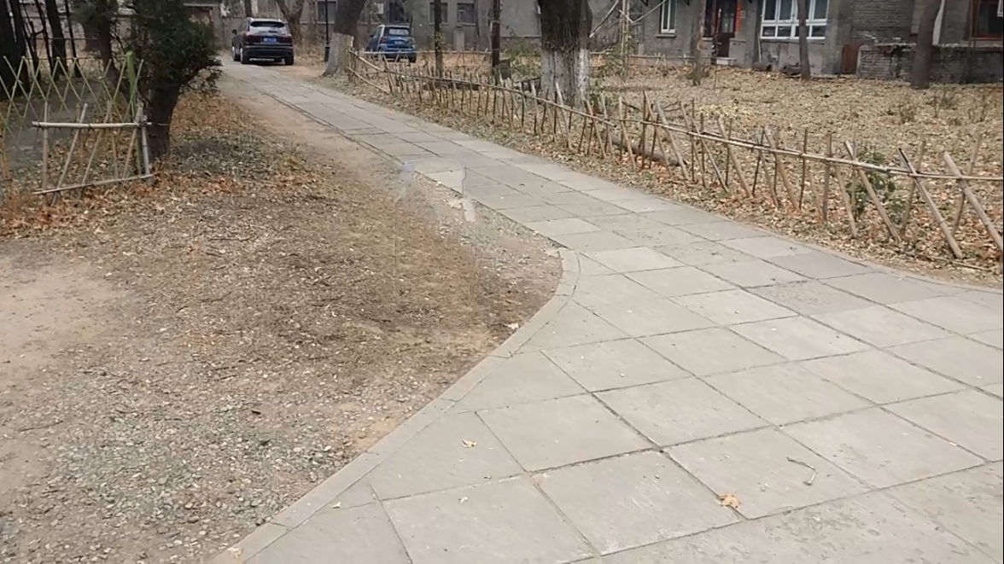
Result: Video Inpainting

Slide 25
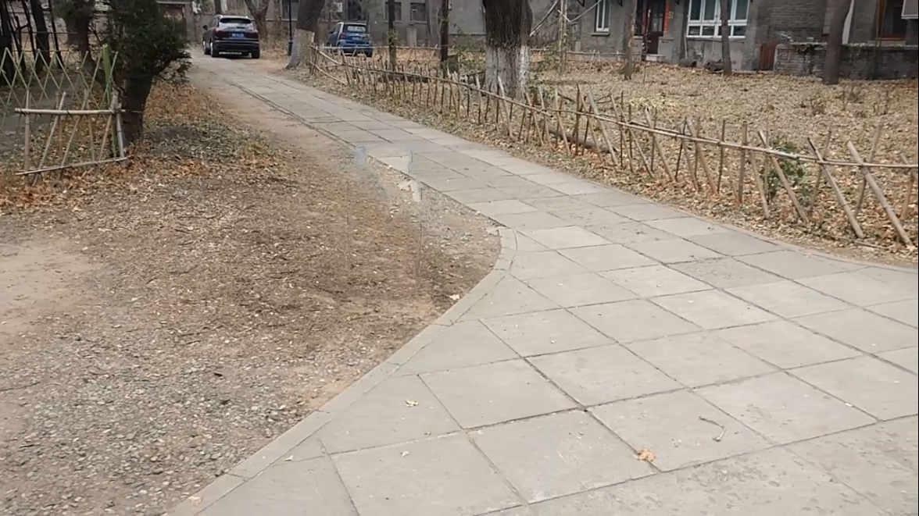
Result: Video Inpainting

Slide 26
Thank you!

Slide 27
Title and Content Layout with Chart

Slide 28
Two Content Layout with Table
First bullet point here
Second bullet point here
Third bullet point here
Class | Group A | Group B
Class 1 | 82 | 95
Class 2 | 76 | 88
Class 3 | 84 | 90

Slide 29
Two Content Layout with SmartArt
Group A
Task 1
Task 2
Group B
Task 1
Task 2
Group C
Task 1
First bullet point here
Second bullet point here
Third bullet point here

Slide 30
Add a Slide Title - 1

Slide 31
Add a Slide Title - 2

Slide 32
Add a Slide Title - 3

Slide 34
Add a Slide Title - 4

Slide 35
Add a Slide Title - 5

